Slide 1
FAFSA Completions as of 11/18/16
Please note report uses the publicly available Department of Education data, which differs slightly from the individual student data advisors see on their Counselor Suite portal. Unless provided by district, percentages are calculated using 2017 senior class estimates.

Slide 2
Dallas County has 1,844 more completions in wk nine in the 2017/18 FAFSA cycle than wk nine in 2016/17
WEEK 9 | 11.25.16
Weekly FAFSA submissions over time
Actual FAFSA completion versus target
Dallas County completed FAFASA submissions to date
FAFSA Completions – Week 9
6,251 submissions to meet 2017/18 target of 13,251 (48%)
Notes:
ED Data, 2016 and Oct PEIMS Snapshot *Please note this is using the publicly available Department of Education data, which differs slightly from the individual student data advisors can see on their Counselor Suite portal. Percentages are calculated using the October 1 PEIMS senior snapshot.)
Don’t forget completion means a student is ready for a financial aid award letter. In other words the student has no missing items on their FAFSA and if they were selected for verification, they have completed that process.

Slide 3
12 of 15 districts have more completions in week nine of this year’s cycle than they did in week nine last year
WEEK 9 | 11.25.16
Percent of Seniors Completing FAFSA by District
Year To Date as of Week Nine (November 25, 2016)
# completing FAFSA,
Wk 9 2017/18
305
241
613
255
153
110
27
364
219
405
1944
921
497
350
518
78
County goal: 48%
% completing FAFSA,
Wk 9 2016/17
41%
17%
14%
30%
27%
19%
33%
13%
15%
19%
20%
16%
20%
16%
18%
17%
Y/Y delta, %
23%
22%
16%
-1%
1%
8%
-7%
12%
10%
6%
4%
7%
3%
7%
2%
-1%

Slide 4
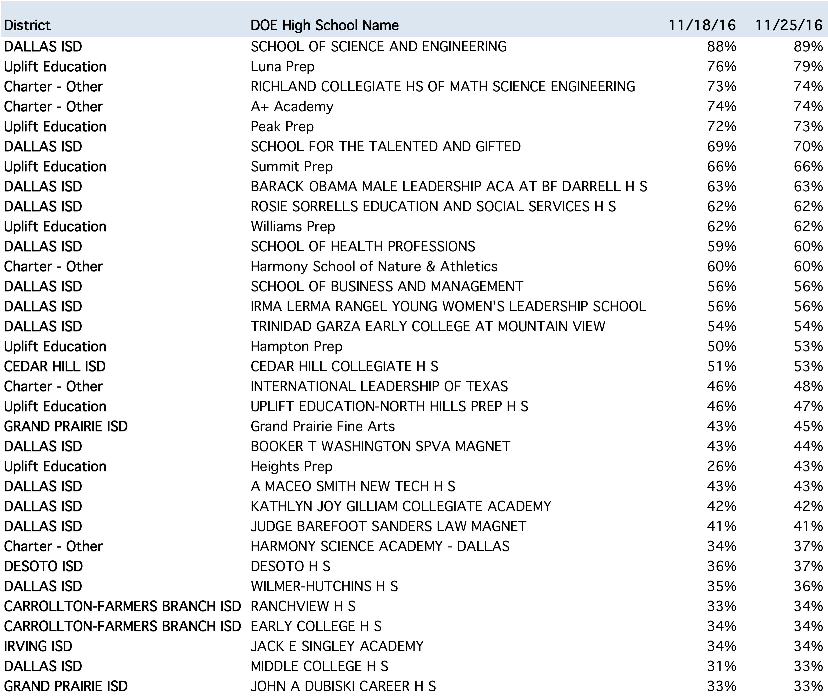
At 33 campuses, at least one third of seniors have completed their FAFSA application
WEEK 9 | 11.25.16

Slide 5
Dallas County has 2,537 more completions in wk eight in the 2017/18 FAFSA cycle than wk eight in 2016/17
WEEK 8 | 11.18.16
Weekly FAFSA submissions over time
Actual FAFSA completion versus target
Dallas County completed FAFASA submissions to date
FAFSA Completions – Week 8
6,468 submissions to meet 2017/18 target of 13,251 (48%)
Notes:
ED Data, 2016 and Oct PEIMS Snapshot *Please note this is using the publicly available Department of Education data, which differs slightly from the individual student data advisors can see on their Counselor Suite portal. Percentages are calculated using the October 1 PEIMS senior snapshot.)
Don’t forget completion means a student is ready for a financial aid award letter. In other words the student has no missing items on their FAFSA and if they were selected for verification, they have completed that process.

